Slide 1


Noida Institute of Engineering and Technology, Greater Noida
Divide and Conquer and Greedy Method
Unit: 3
Design & Analysis of Algorithms
ACSE0501
Anamika Chaudhary
Assistant Professor
DS
DS 5TH SEM

Slide 2

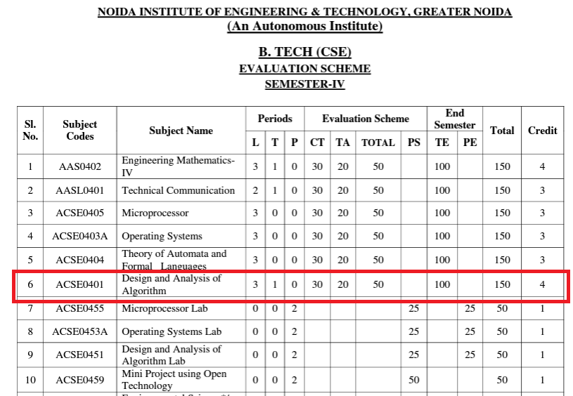
Evaluation Scheme

Slide 3
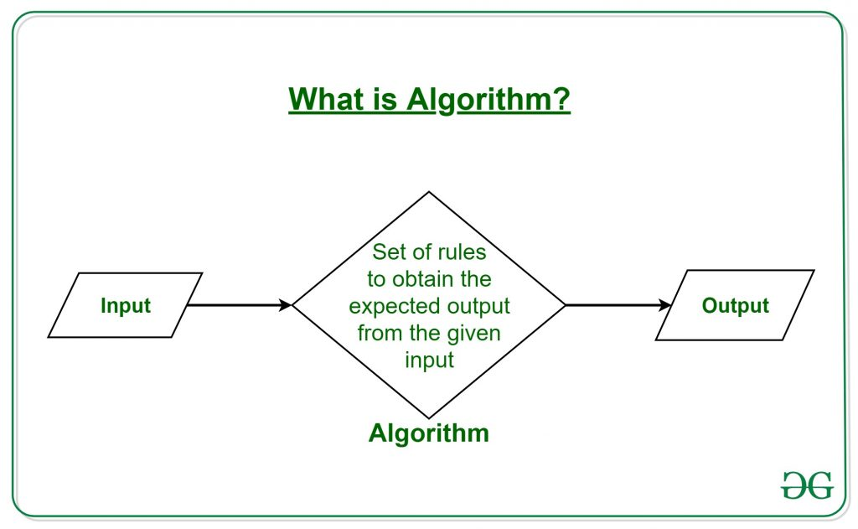
Subject Introduction
The word Algorithm means ” A set of rules to be followed in calculations or other problem-solving operations ” Or ” A procedure for solving a mathematical problem in a finite number of steps that frequently by recursive operations “.
1. https://www.youtube.com/watch?v=0IAPZzGSbME
2. https://www.youtube.com/watch?v=yOl-EpY39kM

Slide 4
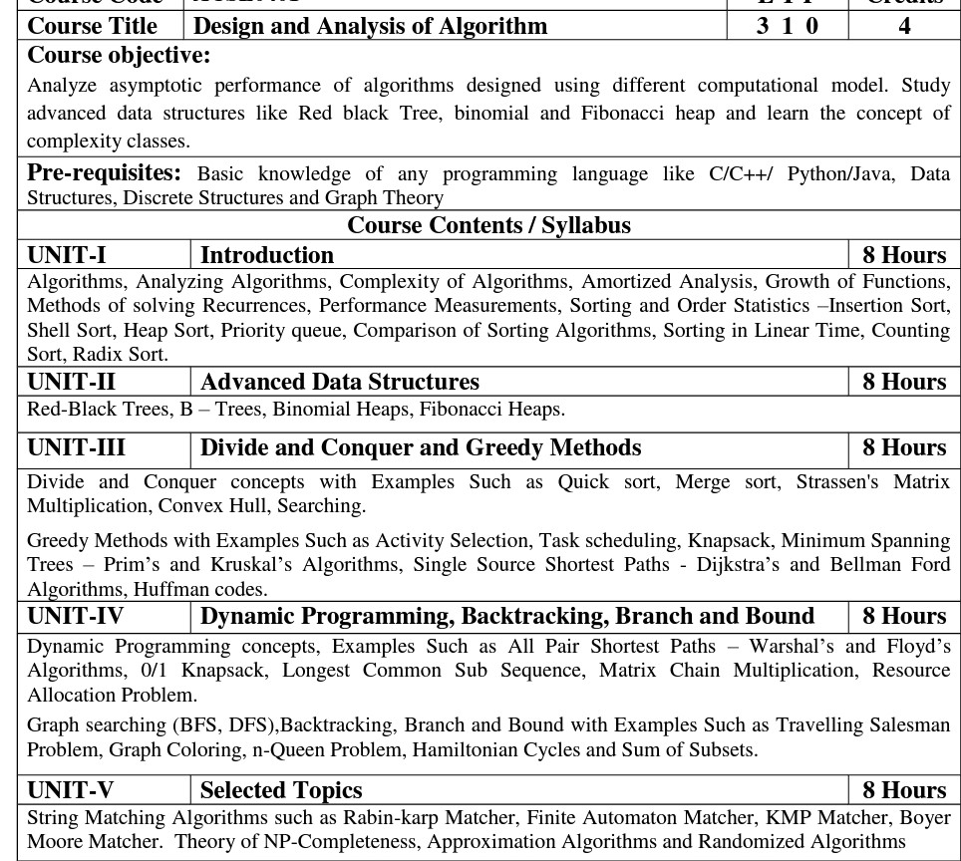
Syllabus

Slide 5
Branch wise Application
First, we will start with the internet which is very much important for our daily life and we cannot even imagine our life without the internet and it is the outcome of clever and creative algorithms. Numerous sites on the internet can operate and falsify this huge number of data only with the help of these algorithms.
The everyday electronic commerce activities are massively subject to our data, for example, credit or debit card numbers, passwords, OTPs, and many more. The centre technologies used incorporate public-key cryptocurrency and digital signatures which depend on mathematical algorithms.
Even an application that doesn't need algorithm content at the application level depends vigorously on the algorithm as the application relies upon hardware, GUI, networking, or object direction and all of these create a substantial use of algorithms.
There are some other vital use cases where the algorithm has been used such as if we watch any video on YouTube then next time we will get related-type advice as recommended videos for us.

Slide 6
Course Objective
Upon completion of this course, students will be able to do the following:
Analyze the asymptotic performance of algorithms.
Write rigorous correctness proofs for algorithms.
Demonstrate a familiarity with major algorithms and data structures.
Apply important algorithmic design paradigms and methods of analysis.
Synthesize efficient algorithms in common engineering design situations.

Slide 7
Course Outcome
At the end of the semester, the student will be able:
 | Description | Bloom’s Taxonomy
CO1 | To have knowledge of basic principles of algorithm design and Analysis, asymptotic notations and growth of functions for time and space complexity analysis and applying the same in different sorting algorithms | Knowledge, analysis And design
CO2 | To apply different problem-solving approaches for advanced data structures | Knowledge, analysis And apply
CO3 | To apply divide and conquer method for solving merge sort, quick sort, matrix multiplication and Greedy Algorithm for solving different Graph Problem. | Knowledge, analysis and Apply
CO4 | To analyze and apply different optimization techniques like dynamic programming, backtracking and Branch & Bound to solve the complex problems | Knowledge, Analysis And Apply
CO5 | To understand the advanced concepts like NP Completeness and Fast Fourier Transform, to analyze and apply String Matching, Approximation and Randomized Algorithms to solve the complex problems | Knowledge, Analysis and Apply

Slide 8
Program Outcome
At the end of the semester, the student will be able:
POs | Engineering Graduates will be able to
PO1 | Engineering Knowledge
PO2 | Problem Analysis
PO3 | Design & Development of solutions
PO4 | Conduct Investigation of complex problems
PO5 | Modern Tool Usage
PO6 | The Engineer and Society
PO7 | Environment and sustainability
PO8 | Ethics
PO9 | Individual & Team work
PO10 | Communication
PO11 | Project management and Finance
PO12 | Life Long Learning

Slide 9
CO-PO and PSO Mapping
Design and Analysis of Algorithm (kCS-502)
CO.K | PO1 | PO2 | PO3 | PO4 | PO5 | PO6 | PO7 | PO8 | PO9 | PO10 | PO11 | PO12
ACSE0401.1 | 3 | 3 | 3 | 3 | 2 | - | - | - | 2 | 2 | - | 3
ACSE0401.2 | 3 | 3 | 3 | 3 | 2 | 2 | - | 1 | 1 | 1 | - | 3
ACSE0401.3 | 3 | 3 | 2 | 3 | 3 | 2 | - | 2 | 1 | 1 | 2 | 3
ACSE0401.4 | 3 | 3 | 3 | 3 | 2 | 2 | - | 2 | 2 | 1 | 3 | 3
ACSE0401.5 | 2 | 2 | 2 | 2 | 2 | 2 | - | 2 | 1 | 1 | 1 | 2
Average | 2.8 | 2.8 | 2.6 | 2.8 | 2.2 | 1.6 | - | 1.8 | 1.4 | 1.2 | 1.2 | 2.8

Slide 10
Program Educational Objectives(PEOs)
PEO1: To have an excellent scientific and engineering breadth so as to
comprehend, analyze, design and provide sustainable solutions for
real-life problems using state-of-the-art technologies.
PEO2:To have a successful career in industries, to pursue higher studies or
to support entrepreneurial endeavors and to face global challenges.
PEO3:To have an effective communication skills, professional attitude,
ethical values and a desire to learn specific knowledge in emerging
trends, technologies for research, innovation and product
development and contribution to society.
PEO4: To have life-long learning for up-skilling and re-skilling for
successful professional career as engineer, scientist, entrepreneur
and bureaucrat for betterment of society

Slide 11
Result Analysis
2022-23​
Overall Result: 97%​
Ms Priya(Section A): 98.4​
Mr. Manish Chaudhry(Section B): 98.46​
Ms. Priya(Section C): 94.28​
​
2021-22​
Overall Result: 94%​
Mr. Nagesh Sharma (Section A&B): 95.59​
Mr. Dileep Kushwaha (Section C): 94.12​

Slide 12
End Semester Question Paper Template
B TECH
(SEM-V) THEORY EXAMINATION 20__-20__
Design and Analysis of Algorithms
Time: 3 Hours Total Marks: 100
Note: 1. Attempt all Sections. If require any missing data; then choose suitably.
SECTION A
Attempt all questions in brief. 2 x 10 = 20
Q.No. | Question | Marks | CO
1 |  | 2
2 |  | 2
. |  | .
10 |  | 2

Slide 13
End Semester Question Paper Templates
SECTION B
2. Attempt any three of the following: 3 x 10 = 30
SECTION C
3. Attempt any one part of the following: 1 x 10 = 10
Q.No. | Question | Marks | CO
1 |  | 10
2 |  | 10
. |  | .
5 |  | 10
Q.No. | Question | Marks | CO
1 |  | 10
2 |  | 10

Slide 14
End Semester Question Paper Templates
4. Attempt any one part of the following: 1 x 10 = 10
5. Attempt any one part of the following: 1 x 10 = 10
6. Attempt any one part of the following: 1 x 10 = 10
Q.No. | Question | Marks | CO
1 |  | 10
2 |  | 10
Q.No. | Question | Marks | CO
1 |  | 10
2 |  | 10
Q.No. | Question | Marks | CO
1 |  | 10
2 |  | 10

Slide 15
Prerequisite and Recap
Prerequisite
Basic concept of c programming language.
Concept of stack, queue and link list.
Recap
Flow Chart
Algorithm

Slide 16
Topic Objective- Divide and Conquer
The divide-and-conquer paradigm is often used to find an optimal solution of a problem.
Its basic idea is to decompose a given problem into two or more similar, but simpler, sub problems, to solve them in turn, and to compose their solutions to solve the given problem.

Slide 17
Divide And Conquer(CO3)
The topic will cover following contents
Sorting: merge sort and quick sort
Binary search
Convex hull – Quick Hull algorithm
Matrix multiplication - Strassen’s algorithm

Slide 18
Divide and Conquer(CO3)
Divide the problem into a number of sub-problems
Similar sub-problems of smaller size
Conquer the sub-problems
Solve the sub-problems recursively
Sub-problem size small enough ⇒ solve the problems in straightforward manner
Combine the solutions of the sub-problems
Obtain the solution for the original problem

Slide 19
Divide-and-conquer technique(CO3)
a problem of size n
subproblem 1
of size n/2
subproblem 2
of size n/2
a solution to
subproblem 1
a solution to
subproblem 2
a solution to
the original problem

Slide 20
Divide and Conquer(CO3)
Merge Sort
To sort an array A[p . . r]:
Divide
Divide the n-element sequence to be sorted into two subsequences of n/2 elements each
Conquer
Sort the subsequences recursively using merge sort
When the size of the sequences is 1 there is nothing more to do
Combine
Merge the two sorted subsequences

Slide 21
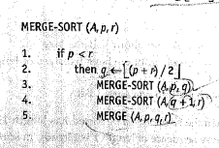
Divide and Conquer(CO3)
Algorithm: Merge –Sort (A,p,r)

Slide 22
Divide and Conquer(CO3)
The procedure Merge- Sort (A,p,r) sorts the element in the subarray A[p……r], if p<=r .
The divide step simply computes the index q that partitions the array into two subarrays of size A[p…..q] and A[q+1…r] of size n/2 both.
Merge (A, p, q, r) function is used to merge the two arrays in sorted sequence. It merges them to form a single sorted subarrays.
Input: <5, 4, 6, 1, 3 ,2, 6>
First, call Merge –Sort (A, 1, length[A])

Slide 23
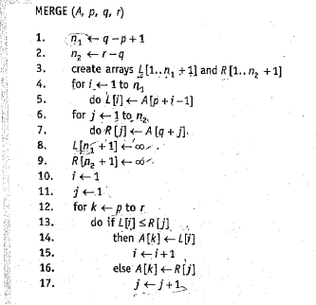
Divide and Conquer(CO3)

Slide 24
Divide and Conquer(CO3)
1.Divide In this step, we find the midpoint of the given array by using the formula mid=start+(end-start)/2
2. Conquer In this step, we divide the array into subarrays using the midpoint calculated. We recursively keep dividing the array and keep calculating the midpoint for doing the same. It is important to note that a single array element is always sorted.
So, our aim is to continuously divide until all elements in the array are single array elements. Once that is done, the array elements are combined back to form a sorted array.
3. Combine Now that all our subarrays are formed, it is now time to combine them in sorted order.

Slide 25
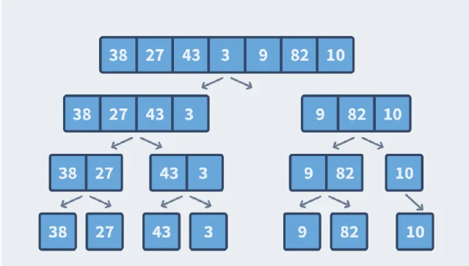
Divide and Conquer(CO3)

Slide 26
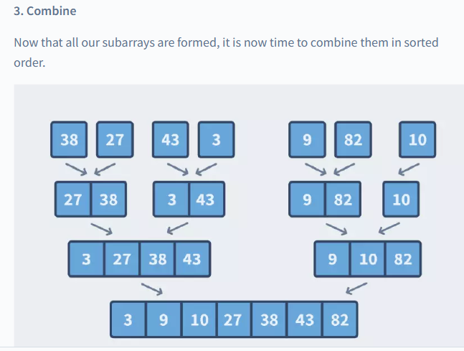
Divide and Conquer(CO3)

Slide 27
Divide and Conquer(CO3)
Merge Sort
Divide:
compute q as the average of p and r: O(n) = Θ(1)
Conquer:
recursively solve 2 subproblems, each of size n/2 ⇒ 2T (n/2)
Combine:
MERGE on an n-element subarray takes Θ(n) time ⇒ C(n) = Θ(n)
Θ(1) if n =1
T(n) = 2T(n/2) + Θ(n) if n > 1

Slide 28
Divide and Conquer(CO3)
Time Complexity of Merge Sort :
Best Case: O(n log n)
Average Case : O(n log n)
Worst Case: O(n log n)
*Because it divides the array into 2 subparts and merges it in linear time.
Space Complexity : O(n)
* An additional array is required to store the final sorted array.

Slide 29
Divide and Conquer(CO3)
Drawbacks of Merge Sort:
The drawbacks of Merge Sort are as follows:
We have seen that we need to store the sorted elements in a separate array of size n, this requires more space thereby increasing the space complexity.
We have also seen that the pointers traverse through one entire sub-array. Let us consider the case where the subarrays are perfectly sorted.
For example subarray1={1,2,3} and subarray2={4,5,6}. The final sorted array looks like this {1,2,3,4,5,6} which is just subarray2 kept after subarray1 but we still need to traverse the entire array thereby wasting time.
Merge Sort when considered for smaller arrays can prove to be slower as compared to other algorithms.

Slide 30
Divide and Conquer(CO3)
Q 1. Sort the list < 70, 80, 40, 50, 60, 12, 35, 95, 10 > using Merge sort.
Q2. Among Merge sort , Insertion Sort and Bubble sort which sorting technique is best in best and worst case? Also justify your answer.
Q3. Consider the following list of elements as < 50, 40, 20, 70, 15, 35, 20,60 > Sort the above list using merge sort.

Slide 31
Divide and Conquer(CO3)
Quick sort
Select a pivot (partitioning element)
Rearrange the list so that all the elements in the positions before the pivot are smaller than or equal to the pivot and those after the pivot are larger than the pivot (See algorithm Partition in section 4.2)
Exchange the pivot with the last element in the first (i.e., ≤ sublist) – the pivot is now in its final position
Quick sort is an inplace sorting technique.
Sort the two sublists
p
A[i]≤p
A[i]>p

Slide 32
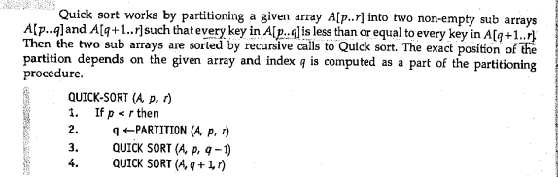
Divide and Conquer(CO3)

Slide 33
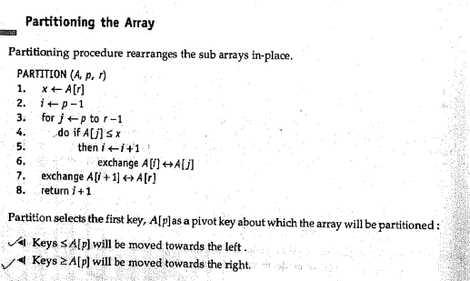
Divide and Conquer(CO3)

Slide 34
Divide and Conquer(CO3)
Analysis of Quick sort:
Best-Case:
The best-case occurs when the pivot is almost in the middle of the array, and the partitioning is done in the middle. So, let us assume that we have a total of n elements in the array, and we are dividing the array from the middle.
In this case, with each partition, we will have at most n/2 elements. And we have to perform the partition until only one element is left in each subarray. The following is the tree representation of the given condition

Slide 35
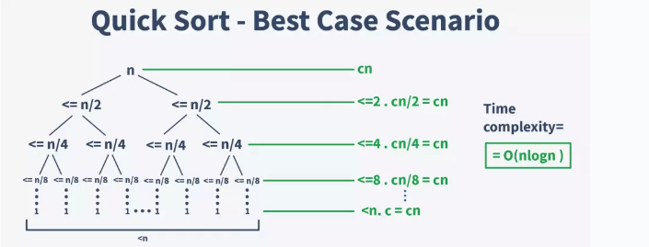
Divide and Conquer(CO3)

Slide 36
Divide and Conquer(CO3)
Worst-Case:
The Worst-case occurs when either of the two partitions is unbalanced. This generally happens when the greatest or smallest element is selected as the pivot.
In this case, the pivot lies at the extreme of the array, and one subarray is always empty while the other contains n – 1 elements.
This way, in the first call, the array is divided into two subarrays of 0 &
n – 1 elements respectively. For the second call, the array with n – 1 elements is divided into two subarrays of 0 & n – 2 elements respectively. This continues till only one element is left.
The time complexity, in this case, would be the sum of all the complexities at each step.
T(quicksort) = T(n) + T(n – 1) + T(n – 2) + …….. + 2 + 1
T(quicksort) = O((n * (n – 1))/2)

Slide 37
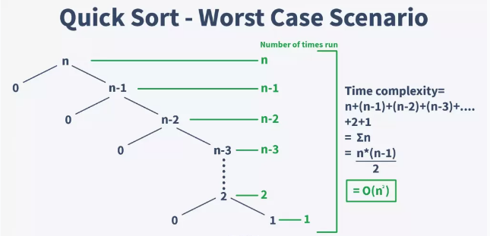
Divide and Conquer(CO3)

Slide 38
Divide and Conquer(CO3)
The average space complexity of a quick sort algorithm is equal to O(logn).
Space Complexity = O(n)
Conclusion :
Quick Sort method sorts the elements using the Divide and Conquer approach.
It has an average O(nlogn) complexity.
It can be implemented in both recursive and iterative ways.
Quick Sort is in-place, cache-friendly, and also a tail-recursive algorithm

Slide 39
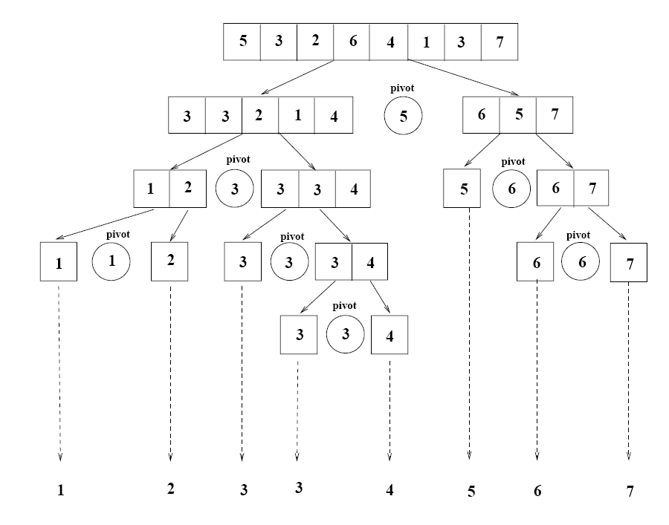
Divide and Conquer(CO3)

Slide 40
Divide and Conquer(CO3)
Q1. Show how quick sort behaves for following sequence of elements:
<2, 3, 18, 7, 5, 1 >
< 1, 1, 1, 1, 1, 1, 1, 1 >
<1, 2, 3, 4, 5, 6, 7 >
< 5, 4, 3, 2, 1 >
Q2. Why quick sort runs faster than merge sort?
Q3. Where is quick sort used?
Q4. Is quick sort a stable algorithm ?

Slide 41
Divide and Conquer(CO3)
Strassen Matrix Multiplication Method
Strassen observed [1969] that the product of two matrices A and B (of size 2^{n}x2^{n}) can be computed as follows:
C₀₀ C₀₁ A₀₀ A₀₁ B₀₀ B₀₁
= *
C₁₀ C₁₁ A₁₀ A₁₁ B₁₀ B₁₁
M₁ + M₄ - M₅ + M₇ M₃ + M₅
=
M₂ + M₄ M₁ + M₃ - M₂ + M₆

Slide 42
Divide and Conquer(CO3)
Strassen Multiplication Method
Sub Matrices
M₁ = (A₀₀ + A₁₁) * (B₀₀ + B₁₁)
M₂ = (A₁₀ + A₁₁) * B₀₀
M₃ = A₀₀ * (B₀₁ - B₁₁)
M₄ = A₁₁ * (B₁₀ - B₀₀)
M₅ = (A₀₀ + A₀₁) * B₁₁
M₆ = (A₁₀ - A₀₀) * (B₀₀ + B₀₁)
M₇ = (A₀₁ - A₁₁) * (B₁₀ + B₁₁)

Slide 43
Divide and Conquer(CO3)
Time Complexity of Strassen’s Method Addition and Subtraction of two matrices takes O(N²) time. So time complexity can be written as
T(N) = 7T(N/2) + O(N²)
From Master's Theorem, time complexity of above method is O(N^{log7}) which is approximately O(N^{2.8074})
For more examples refer the link
https://www.youtube.com/watch?v=0oJyNmEbS4w

Slide 44
Quiz
1. Given the recurrence f(n) = 4 f(n/2) + 1, how many sub-problems will a divide-and-conquer algorithm divide the original problem into, and what will be the size of those sub-problems?
a) 4 sub-problems, each of size 2
b) 4 sub-problems, each of size n/2
c) 2 sub-problems, each of size 4
d) 2 sub-problems, each of size n/4
2. A sorting technique that guarantees, that records with the same primary key occurs, in the same order in the sorted list as in the original unsorted list is said to be:
A) stable
b) Consistent
c) External
d) Linear

Slide 45
Topic Objective- Greedy Algorithm
This objective of this topic is to make the students aware about the following concepts
Graph
Dijkstra Algorithm
Kruskals Algorithm
Prim Algorithm
Huffman Coding
Activity Selection Problem
Knapsack problem

Slide 46
Prerequisite and Recap
Prerequisite
Graph
Different operations
Notations
Recap
Algorithm analysis
Analysis of different sorting and searching algorithms using divide and conquer.

Slide 47
Greedy Algorithm (CO3)
Graph
Directed Graph
Undirected Graph
Degree of Graph
Graph Representation
Spanning Tree
Kruskal’s Method
Prims Method
Single-Source Shortest Paths
Dijkstra's Algorithm
Knapsack Problem

Slide 48
Greedy Algorithm (CO3)
Graph A graph G = (V, E) as a collection of adjacency lists or as an adjacency matrix. Where V is set of vertex (node) and E is a set of edges (link). There are two types of graph: directed and undirected graphs.
Directed graph (or digraph) It is a graph with directed edges. Edges have directions so they are represented by arrows. Each edge leaves a vertex and enters a vertex.
Undirected graph It is a graph with undirected edges. Edges have no directions so they are represented by lines.

Slide 49
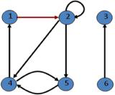
Greedy Algorithm (CO3)
Degree (Directed Graph)
The out-degree of a vertex is the number of edges leaving it. The out-degree of vertex 2 is 3.
The in-degree of a vertex is the number of edges entering it. The in-degree of vertex 2 is 2.
degree=out-degree+ in-degree

Slide 50
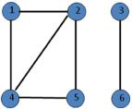
Greedy Algorithm (CO3)
Degree (Undirected Graph)
In an undirected graph,
The out-degree and the in-degree are not defined.
Only the degree of a vertex is defined. The degree of vertex 2 is 3.

Slide 51
Greedy Algorithm (CO3)
Representation of Graph Given graph G = (V, E). May be either directed or undirected. Two common ways to represent for algorithms:
Adjacency-list representation
Adjacency-matrix representation

Slide 52
Greedy Algorithm (CO3)
Adjacency-list representation
An array of |V| lists, one for each vertex. For vertex u, its adjacency list contains all vertices adjacent to u. The adjacency-list representation is usually preferred, because it provides a compact way to represent sparse graph- those for which |E| is much less than |V|² .

Slide 53
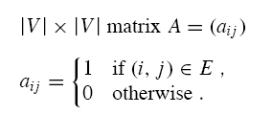
Greedy Algorithm (CO3)
Adjacency-matrix representation
An Adjacency-matrix representation may be preferred, when the graph is dense -|E| is close to |V|² or when we need to be able to tell quickly if there is an edge connecting two given vertices.

Slide 54
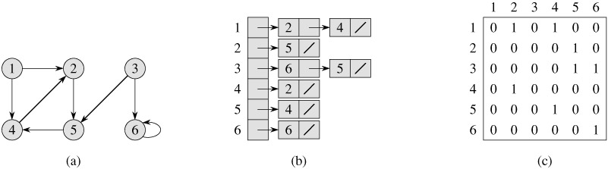
Greedy Algorithm (CO3)
Adjacency-matrix representation of Directed Graph
Graph
Adjacency list
Adjacency matrix

Slide 55
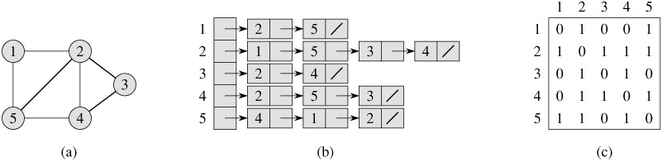
Greedy Algorithm (CO3)
Adjacency-matrix representation of Undirected Graph
Graph
Adjacency list
Adjacency matrix

Slide 56
Greedy Algorithm (CO3)
Minimum Spanning Tree
A spanning tree of a connected graph G contains all the nodes and has edges, which connects all the nodes. So number of edges will be 1 less than the number of nodes.
Spanning Trees: A sub graph T of a undirected graph G=(V,E) is a spanning tree of G if it is a tree and contains every vertex of G.
A minimum spanning tree is a sub graph of an undirected weighted graph G, such that

Slide 57
Greedy Algorithm (CO3)
Algorithm of Kruskal's
For any graph, G=(V,E), finding an MST using Kruskal's algorithm involves the following steps –
Sort all the edges of the graph in ascending order of their weights.
Check the edge with minimum weight, if including it in the answer forms a cycle discard it, otherwise include it in the answer.
Repeat the above step until we have chosen V−1 edges.

Slide 58
Greedy Algorithm (CO3)
Kruskal’s working Rule
● Select minimum weighted edge in graph
● Choose the next minimum weighted edge
● Repeat step2 until all edges are not explored

Slide 59
Greedy Algorithm (CO3)
Kruskal’s Algorithm Example
List the edges in order of size:
ED 2
AB 3
AE 4
CD 4
BC 5
EF 5
CF 6
AF 7
BF 8
DF 8
B
5
C
3
6
4
8
8
A
F
D
7
5
4
2
E

Slide 60
Greedy Algorithm (CO3)
Kruskal’s Algorithm Example
B
5
C
Select the shortest
edge in the network
ED 2
3
6
4
8
8
A
F
D
7
5
4
2
E

Slide 61
Greedy Algorithm (CO3)
Kruskal’s Algorithm Example
Select the shortest
edge in the network
ED 2
AB 3
B
5
C
3
6
4
8
8
A
F
D
7
5
4
2
E

Slide 62
Greedy Algorithm (CO3)
Kruskal’s Algorithm Example
Select the shortest
edge in the network
ED 2
AB 3
CD 4( or AE 4)
B
5
C
3
6
4
8
8
A
F
D
7
5
4
2
E

Slide 63
Greedy Algorithm (CO3)
Kruskal’s Algorithm Example
Select the shortest
edge in the network
ED 2
AB 3
CD 4( or AE 4)
AE 4
B
5
C
3
6
4
8
8
A
F
D
7
5
4
2
E

Slide 64
Greedy Algorithm (CO3)
Kruskal’s Algorithm Example
Select the shortest
edge in the network
ED 2
AB 3
CD 4( or AE 4)
AE 4
BC FORMS A CYCLE
EF 5
B
5
C
3
6
4
8
8
A
F
D
7
5
4
2
E

Slide 65
Greedy Algorithm (CO3)
Kruskal’s Algorithm Example
Select the shortest
edge in the network
ED 2
AB 3
CD 4( or AE 4)
AE 4
BC FORMS A CYCLE
EF 5
Total Weight of Tree = 18
B
5
C
3
6
4
8
8
A
F
D
7
5
4
2
E

Slide 66
Greedy Algorithm (CO3)
Prims Algorithm
The tree starts from an arbitrary root vertex r and grows until the tree spans all the vertices in V.
● Select any vertex
● Choose the minimum cost adjacent edge of selected vertex
● Repeat step2 until all node are not explored.

Slide 67
Greedy Algorithm (CO3)
Step 1: Select a starting vertex.
Step 2: Repeat Steps 3 and 4 until there are fringe vertices.
Step 3: Select an edge 'e' connecting the tree vertex and fringe vertex that has minimum weight.
Step 4: Add the selected edge and the vertex to the minimum spanning tree T.
[END OF LOOP]
Step 5: EXIT

Slide 68
Greedy Algorithm (CO3)
Prims Algorithm Example
Select any vertex A
Select the shortest edge connected to that vertex
AB 3
B
5
C
3
6
4
8
8
A
F
D
7
5
4
2
E

Slide 69
Greedy Algorithm (CO3)
Prims Algorithm Example
B
5
Select the shortest
edge connected to
any vertex already
connected.
AE 4
C
3
6
4
8
8
A
F
D
7
5
4
2
E

Slide 70
Greedy Algorithm (CO3)
Prims Algorithm Example
Select the shortest
edge connected to
any vertex already
connected.
ED 2
B
5
C
3
6
4
8
8
A
F
D
7
5
4
2
E

Slide 71
Greedy Algorithm (CO3)
Prims Algorithm Example
B
5
C
Select the shortest
edge connected to
any vertex already
connected.
DC 4
3
6
4
8
8
A
F
D
7
5
4
2
E

Slide 72
Greedy Algorithm (CO3)
Prims Algorithm Example
B
5
C
3
Select the shortest
edge connected to
any vertex already
connected.
EF 5
6
4
8
8
A
F
D
7
5
4
2
E

Slide 73
Greedy Algorithm (CO3)
Prims Algorithm Example
All vertices have been
connected.
The solution is
AB 3
AE 4
ED 2
DC 4
EF 5
Total weight of tree: 18
B
5
C
3
4
8
6
8
A
D
7
F
5
4
2
E

Slide 74
Greedy Algorithm (CO3)
Difference Between Kruskal’s and Prim’s Algorithm.
Kruskal’s algorithm
Select the shortest edge in a network
Select the next shortest edge which does not create a cycle
Repeat step 2 until all vertices have been connected
Prims algorithm
Select any vertex
Select the shortest edge connected to that vertex
Select the shortest edge connected to any vertex already connected
Repeat step 3 until all vertices have been connected

Slide 75
Greedy Algorithm (CO3)
Single-Source Shortest Paths
Problem: given a weighted directed graph G, find the minimum weight path from a given source vertex s to another vertex v
● “Shortest-path” = minimum weight
● Weight of path is sum of edges
● E.g., a road map: what is the shortest path from Chapel Hill to Charlottesville?

Slide 76
Greedy Algorithm (CO3)
RELAX(u, v, w)
If d[v] > d[u] +w(u, v)
then d[v] ← d[u] +w(u, v)
π[v] ← u
Initialize Single Source(G, S)
For each vertex v ∈ V[G]
do d[v] ←∞
π[v] ← NIL
d[s] ←0

Slide 77
Greedy Algorithm (CO3)
Dijkstra's (G, W, S)
Initialize Single Source(G, S)
S ←∅
Q ←V[G]
while Q ≠∅
do u ← EXTRACT-MIN(Q)
S←S∪{u}
for each vertex all v ∈ adjacent[u]
do relax(u, v, w)

Slide 78
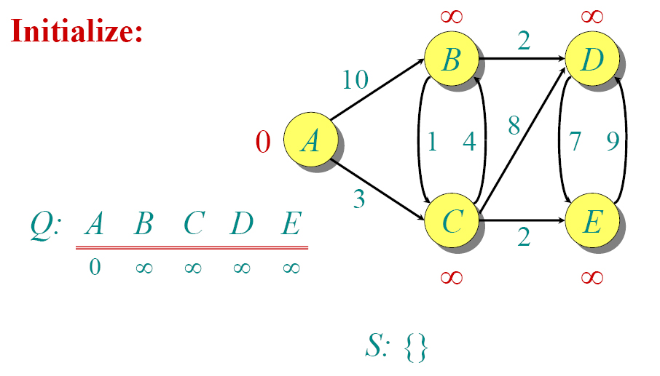
Greedy Algorithm (CO3)
Dijkstra's Example

Slide 79
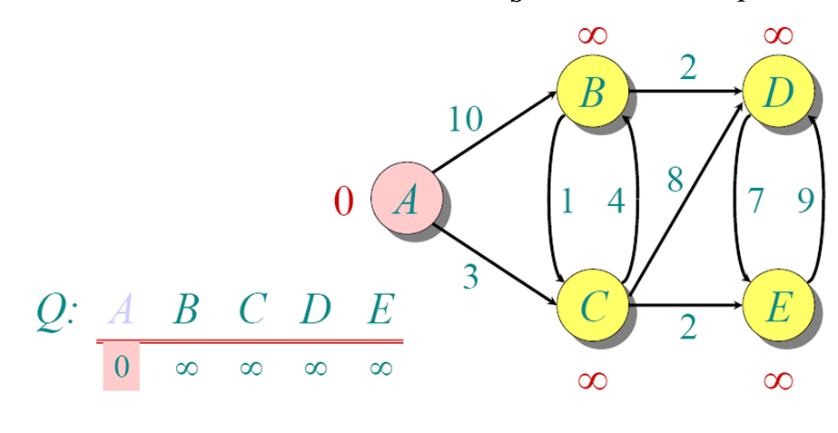
Greedy Algorithm (CO3)
Dijkstra's Example

Slide 80
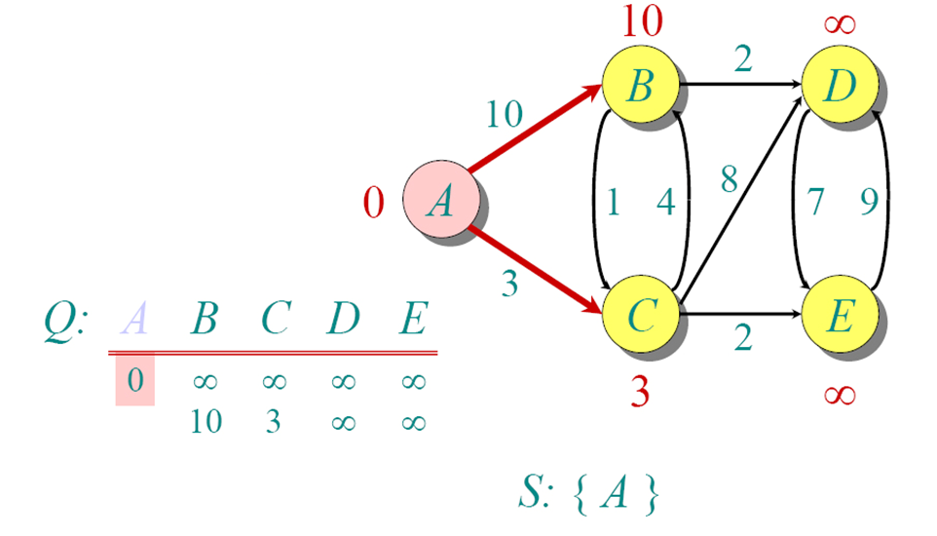
Greedy Algorithm (CO3)
Dijkstra's Example

Slide 81
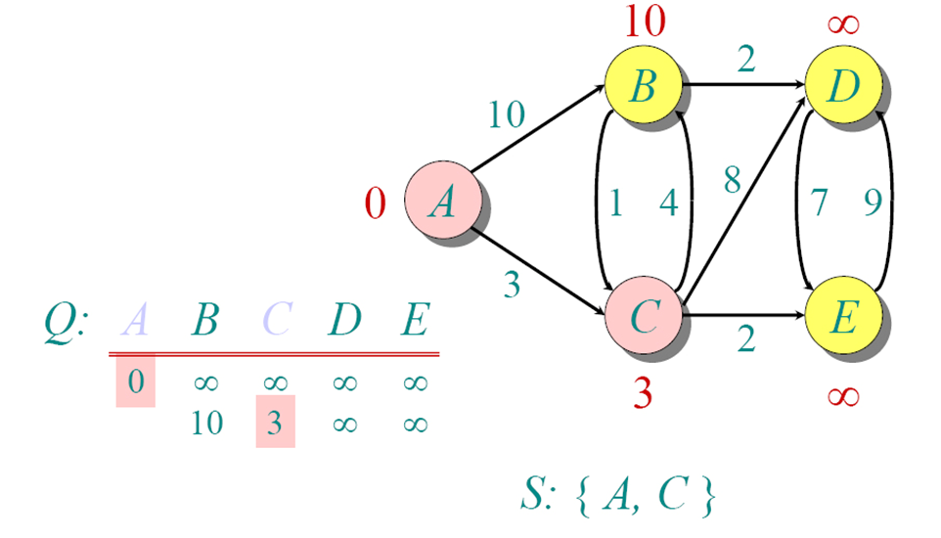
Greedy Algorithm (CO3)
Dijkstra's Example

Slide 82
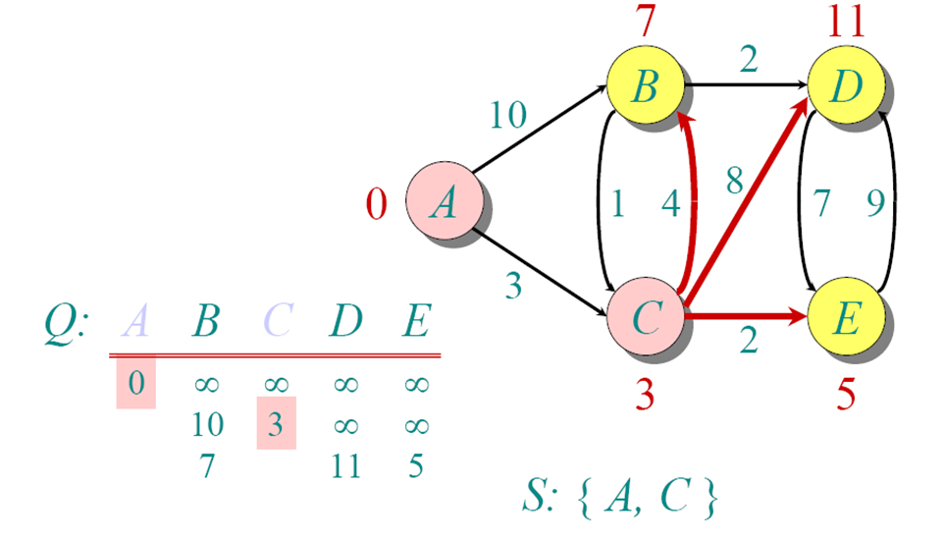
Greedy Algorithm (CO3)
Dijkstra's Example

Slide 83
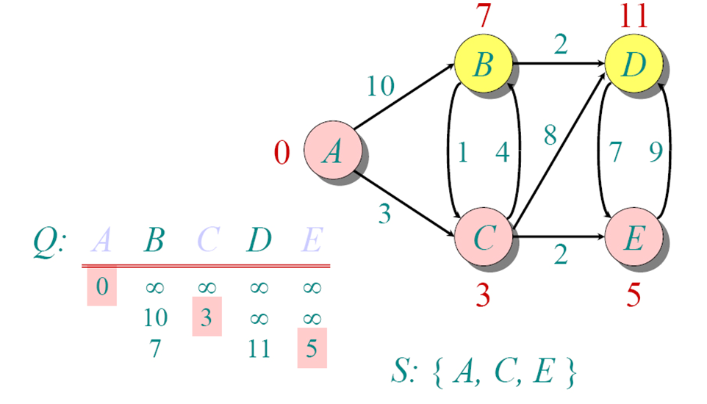
Greedy Algorithm (CO3)
Dijkstra's Example

Slide 84
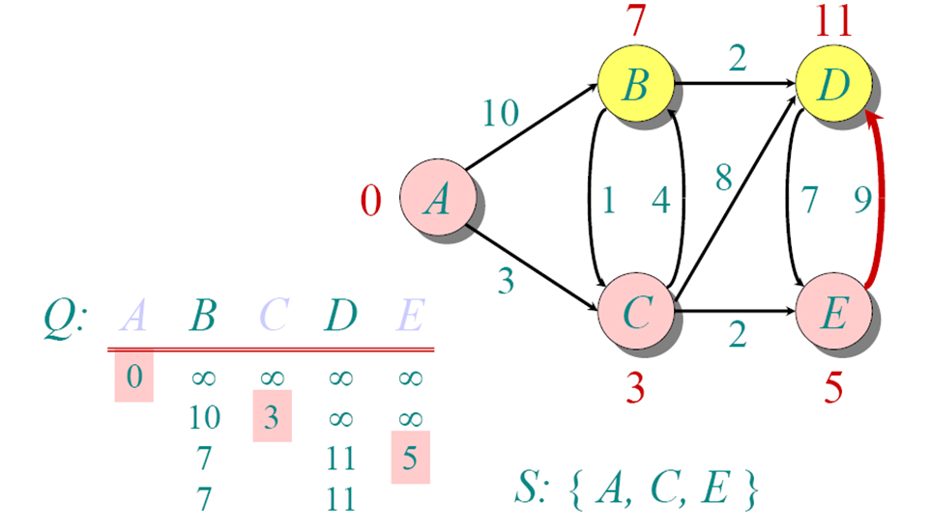
Greedy Algorithm (CO3)
Dijkstra's Example

Slide 85
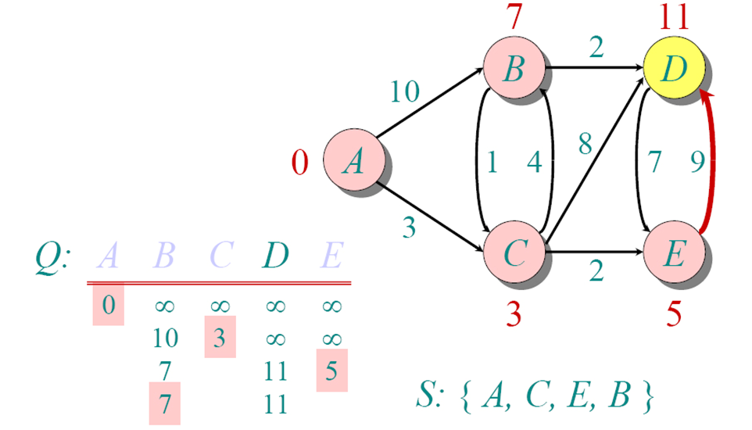
Greedy Algorithm (CO3)
Dijkstra's Example

Slide 86
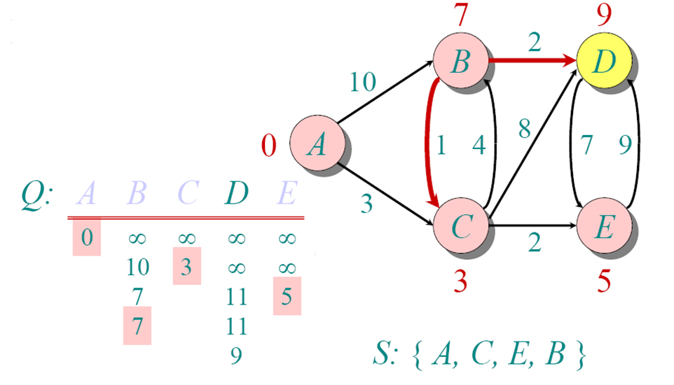
Greedy Algorithm (CO3)
Dijkstra's Example

Slide 87
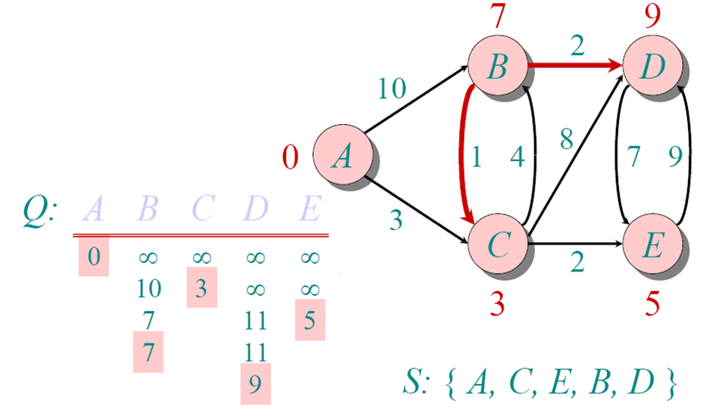
Greedy Algorithm (CO3)
Dijkstra's Example

Slide 88
Greedy Algorithm (CO3)
Bellman Ford (G, W, S)
Initialize Single Source(G, S)
For i ←1 to [V[G]] -1
do for each edge (u, v)∈ E[G]
do relax(u, v, w)
for each edge (u, v)∈ E[G]
do if d[v] > d[u] +w(u, v)
then return false
return true

Slide 89
Greedy Algorithm (CO3)
Example
Let us understand the algorithm with following example graph.
Let the given source vertex be 0. Initialize all distances as infinite, except the distance to the source itself. Total number of vertices in the graph is 5, so all edges must be processed 4 times.

Slide 90
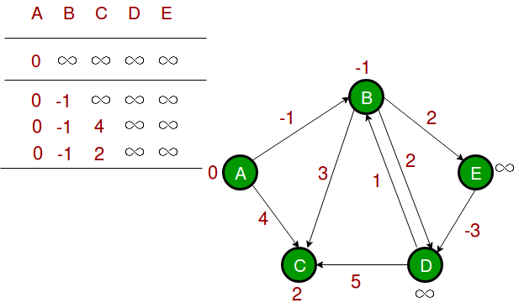
Greedy Algorithm (CO3)
Let all edges are processed in the following order: (B, E), (D, B), (B, D), (A, B), (A, C), (D, C), (B, C), (E, D). We get the following distances when all edges are processed the first time. The first row shows initial distances. The second row shows distances when edges (B, E), (D, B), (B, D) and (A, B) are processed. The third row shows distances when (A, C) is processed. The fourth row shows when (D, C), (B, C) and (E, D) are processed.

Slide 91
Greedy Algorithm (CO3)
The first iteration guarantees to give all shortest paths which are at most 1 edge long. We get the following distances when all edges are processed second time (The last row shows final values).

Slide 92
Greedy Algorithm (CO3)
The second iteration guarantees to give all shortest paths which are at most 2 edges long. The algorithm processes all edges 2 more times. The distances are minimized after the second iteration, so third and fourth iterations don’t update the distances.

Slide 93
Greedy Algorithm (CO3)
Knapsack Problem
There are two versions of the problem:
“0-1 knapsack problem”
Items are indivisible,
you either take an item or not.
“Fractional knapsack problem”
Items are divisible
you can take any fraction of an item

Slide 94
Greedy Algorithm (CO3)
Knapsack Problem
Given a knapsack with maximum capacity W, and a set S consisting of n items
Each item i has some weight w_{i} and benefit value b_{i} (all w_{i} and W are integer values)
Problem: How to pack the knapsack to achieve maximum total value of packed items?

Slide 95
Greedy Algorithm (CO3)
Algorithm:
Greedy-Fractional-Knapsack (w[1..n], p[1..n], W)
for i = 1 to n
do x[i] = 0
weight = 0
for i = 1 to n
if weight + w[i] ≤ W then
x[i] = 1
weight = weight + w[i]
else
x[i] = (W - weight) / w[i]
weight = W
break
return x

Slide 96
Greedy Algorithm (CO3)
Example-
Let us consider that the capacity of the knapsack W = 60 and the list of provided items are shown in the following table −
Item | A | B | C | D
Profit | 280 | 100 | 120 | 120
Weight | 40 | 10 | 20 | 24
Ratio (piwi)(piwi) | 7 | 10 | 6 | 5

Slide 97
Greedy Algorithm (CO3)
As the provided items are not sorted based on pi/wi. After sorting, the items are as shown in the following table.
Item | B | A | C | D
Profit | 100 | 280 | 120 | 120
Weight | 10 | 40 | 20 | 24
Ratio (piwi)(piwi) | 10 | 7 | 6 | 5

Slide 98
Greedy Algorithm (CO3)
Solution
After sorting all the items according to pi/wi. First all of B is chosen as weight of B is less than the capacity of the knapsack. Next, item A is chosen, as the available capacity of the knapsack is greater than the weight of A. Now, C is chosen as the next item. However, the whole item cannot be chosen as the remaining capacity of the knapsack is less than the weight of C.
Hence, fraction of C (i.e. (60 − 50)/20) is chosen.
Now, the capacity of the Knapsack is equal to the selected items. Hence, no more item can be selected.
The total weight of the selected items is 10 + 40 + 20 * (10/20) = 60
And the total profit is 100 + 280 + 120 * (10/20) = 380 + 60 = 440
This is the optimal solution. We cannot gain more profit selecting any different combination of items.

Slide 99
Greedy Algorithm (CO3)
Huffman Coding
we make a new node and then pick the first two nodes from the sorted character and make the first node left child of the new node and second node as the right child of the new node.
The value of the new node is the summation of the values of the children nodes.
Notes:
BSBSwh hwhhdwhw kq1kedbfceJCQK ;DW[
LMHYI;’
;LI

Slide 100
Greedy Algorithm (CO3)
Huffman (C)
n ←[C]
Q ←C
For i ← 1 to n-1
do allocate a new node Z
left[z] ← x ← EXTRACT-MIN(Q)
Right[z] ← y ← EXTRACT-MIN(Q)
F[z] ← F[x] + F[y]
Insert (Q, Z)
Return EXTRACT-MIN(Q)

Slide 101
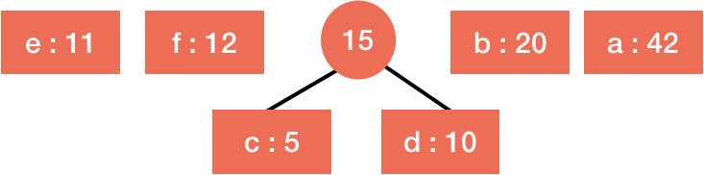
Greedy Algorithm (CO3)
Huffman Coding

Slide 102
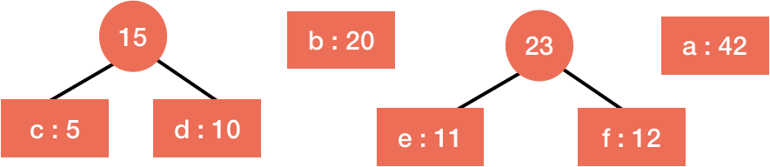
s.
Greedy Algorithm (CO3)
Huffman Coding
We again sort the nodes according to the values and repeat the same process with the first two nodes.

Slide 103
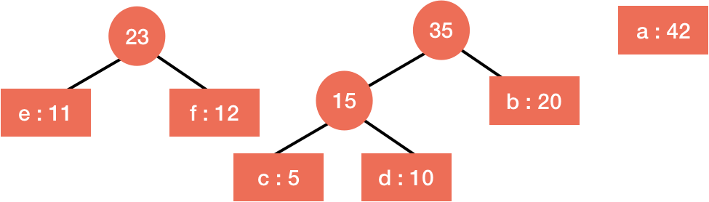
s.
Greedy Algorithm (CO3)
Huffman Coding

Slide 104
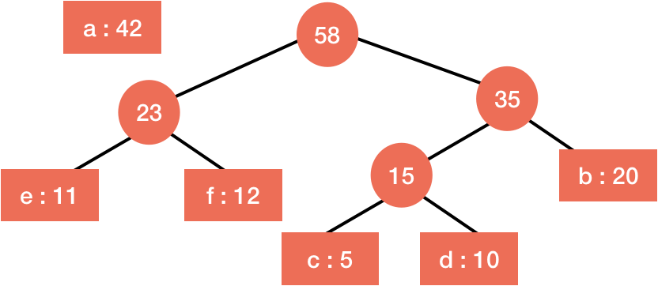
s.
Greedy Algorithm (CO3)
Huffman Coding

Slide 105
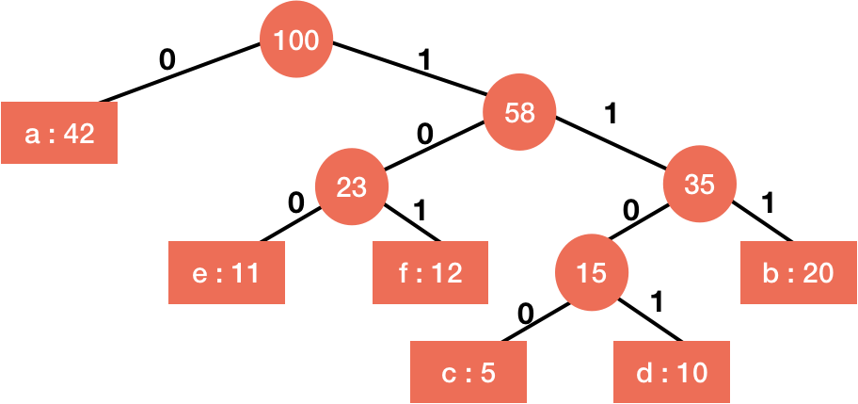
s.
Greedy Algorithm (CO3)
Huffman Coding

Slide 106
Greedy Algorithm (CO3)
Greedy Algorithm (CO3)
Task Scheduling Problem-
A unit-time task is a job, such as a program to be rush on a computer that needed precisely one unit of time to complete. Given a finite set S of unit-time tasks, a schedule for S is a permutation of S specifying the order in which to perform these tasks. The first task in the schedule starts at time 0 and ends at time 1; the second task begins at time 1 and finishes at time 2, and so on.
The dispute of scheduling unit-time tasks with deadlines and penalties for each processor has the following inputs:
a set S = {1, 2, 3.....n} of n unit-time tasks.
a set of n integer deadlines d1 d2 d3...dn such that di satisfies 1≤ di ≤ n and task i is supposed to finish by time di and
a set of n non-negative weights or penalties w1 w2....wn such that we incur a penalty of wi if task i is not finished by time di, and we incurred no penalty if a task finishes by its deadline.

Slide 107
Greedy Algorithm (CO3)
Following is the algorithm.
Sort all jobs in decreasing order of profit.
2) Iterate on jobs in decreasing order of profit.For each job , do the following :
a)Find a time slot i, such that slot is empty and i < deadline and i is greatest.Put the job in this slot and mark this slot filled.
b)If no such i exists, then ignore the job.

Slide 108


Example: Find the optimal schedule for the following task with given weight (penalties) and deadlines.
1 2 3 4 5 6 7
di 4 2 4 3 1 4 6
wi 70 60 50 40 30 20 10
Solution: According to the Greedy algorithm we sort the jobs in decreasing order of their penalties so that minimum of penalties will be charged.
In this problem, we can see that the maximum time for which uniprocessor machine will run in 6 units because it is the maximum deadline.

Slide 109
Let T_{i} represents the tasks where i = 1 to 7
T5 and T6 cannot be accepted after T7 so penalty is
w5 + w6 = 30 + 20 = 50 (2 3 4 1 7 5 6)

Slide 110
Other schedule is
(2 4 1 3 7 5 6)
There can be many other schedules but (2 4 1 3 7 5 6) is optimal.

Slide 111
Greedy Algorithm (CO3)
Activity Selection
To select the activities from a pool of activities so that maximum resources can be utilized without any conflict.
Recursive Activity Selector (s, f, i, j)
m ←i +1
While m < j and s_{m} < f_{i}
do m ← m + 1
if m < j
then return {a_{m}} U Recursive Activity Selector (s, f, m, j)
else Return ∅

Slide 112
Greedy Algorithm (CO3)
Activity Selection
Greedy Activity Selector (s, f)
n ←length[s]
A ← {a₁}
i ← 1
For m ← 2 to n
do if s_{m} >= f_{i}
then A ← A U {a_{m}}
i ← m
Return A

Slide 113
Greedy Algorithm (CO3)
Example 1 : Consider the following 3 activities sorted by
by finish time.
start[] = {10, 12, 20};
finish[] = {20, 25, 30};
A person can perform at most two activities. The maximum set of activities that can be executed is {0, 2} [ These are indexes in start[] and finish[].
Example 2 : Consider the following 6 activities
sorted by by finish time.
start[] = {1, 3, 0, 5, 8, 5};
finish[] = {2, 4, 6, 7, 9, 9};
A person can perform at most four activities. The maximum set of activities that can be executed is {0, 1, 3, 4} [ These are indexes in start[] and finish[].

Slide 114
Bellman Ford Algorithm
Greedy Algorithm (CO3)
Bellman ford algorithm is a single-source shortest path algorithm. This algorithm is used to find the shortest distance from the single vertex to all the other vertices of a weighted graph. There are various other algorithms used to find the shortest path like Dijkstra algorithm, etc. If the weighted graph contains the negative weight values, then the Dijkstra algorithm does not confirm whether it produces the correct answer or not. In contrast to Dijkstra algorithm, bellman ford algorithm guarantees the correct answer even if the weighted graph contains the negative weight values.

Slide 115
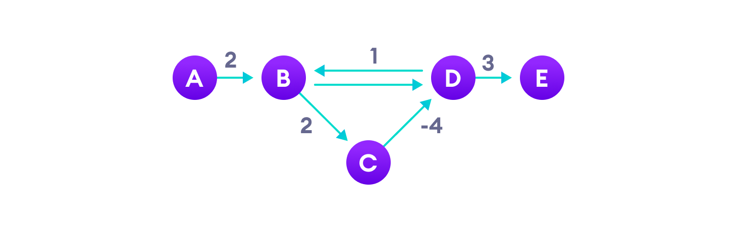
Bellman Ford Algorithm
Negative weight edges can create negative weight cycles i.e. a cycle that will reduce the total path distance by coming back to the same point.

Slide 116
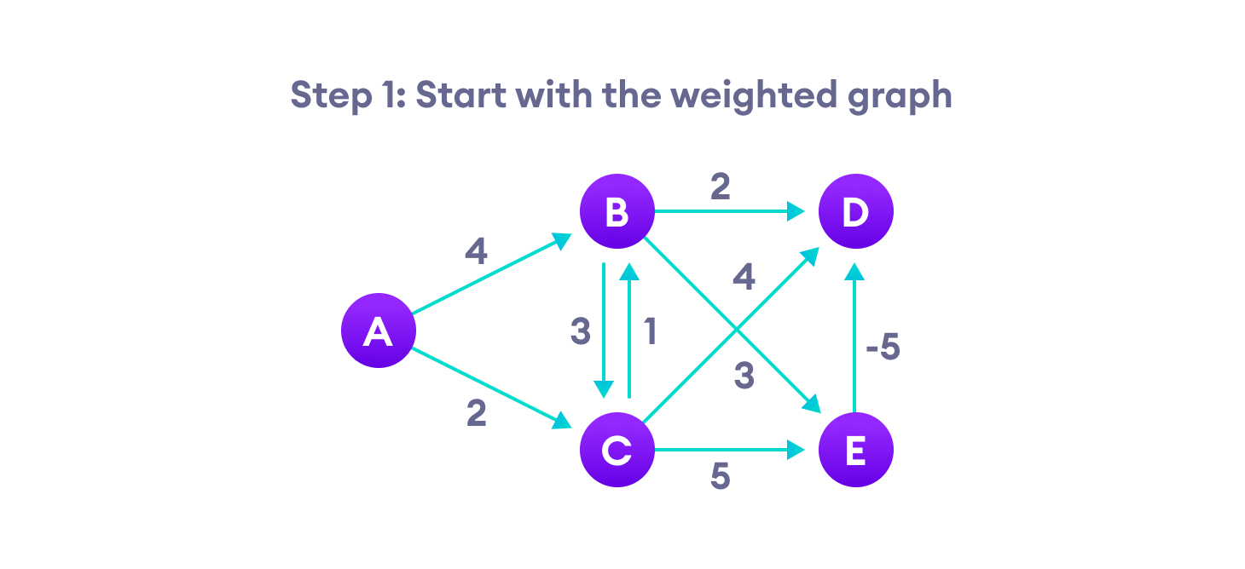
Bellman Ford Algorithm

Slide 117
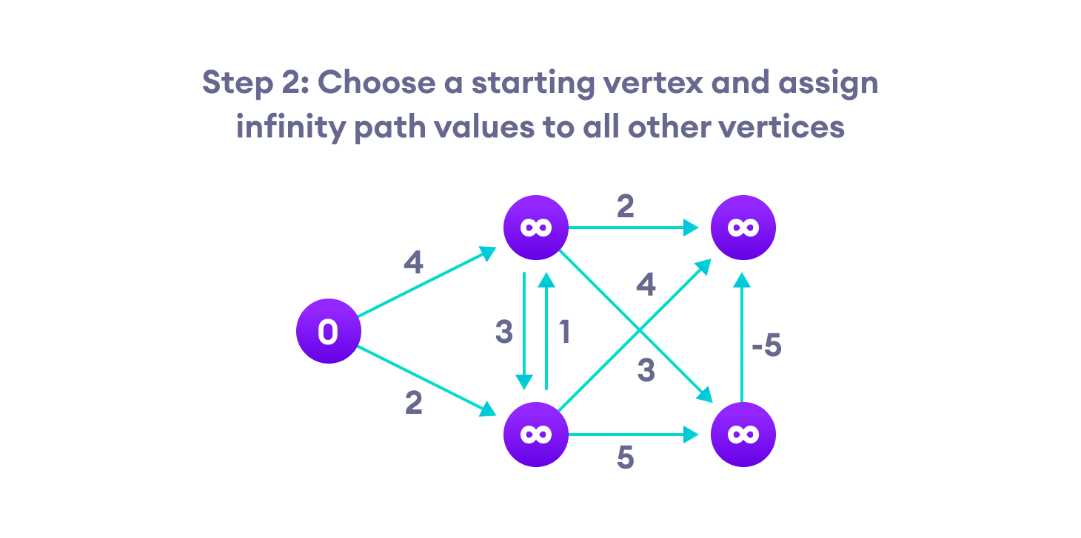
Bellman Ford Algorithm

Slide 118
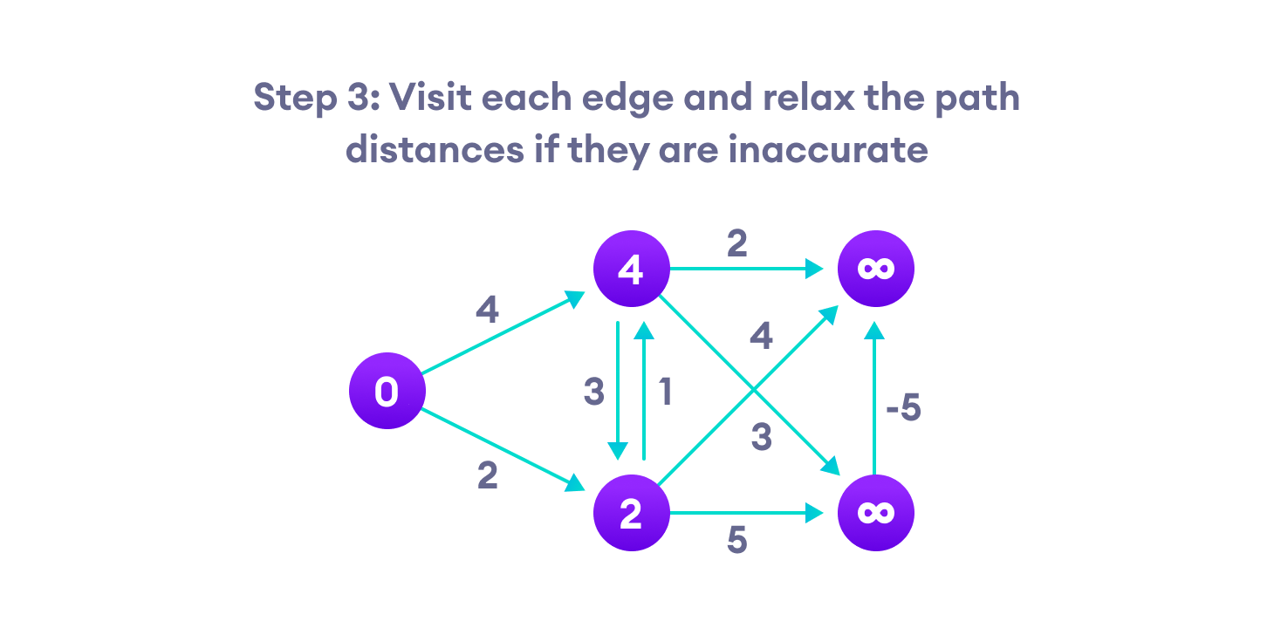
Bellman Ford Algorithm

Slide 119
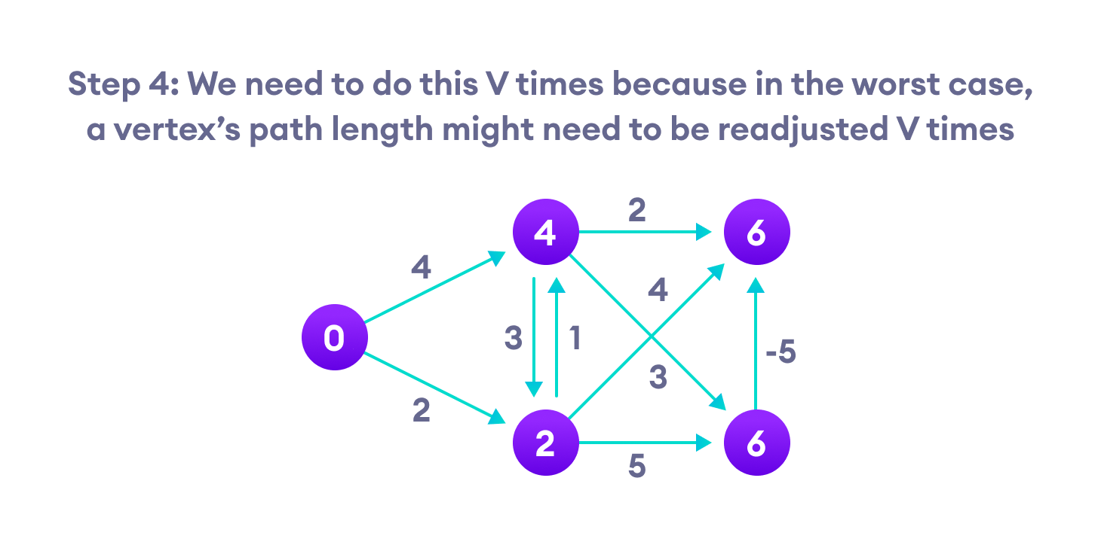
Bellman Ford Algorithm

Slide 120

Bellman Ford Algorithm

Slide 121
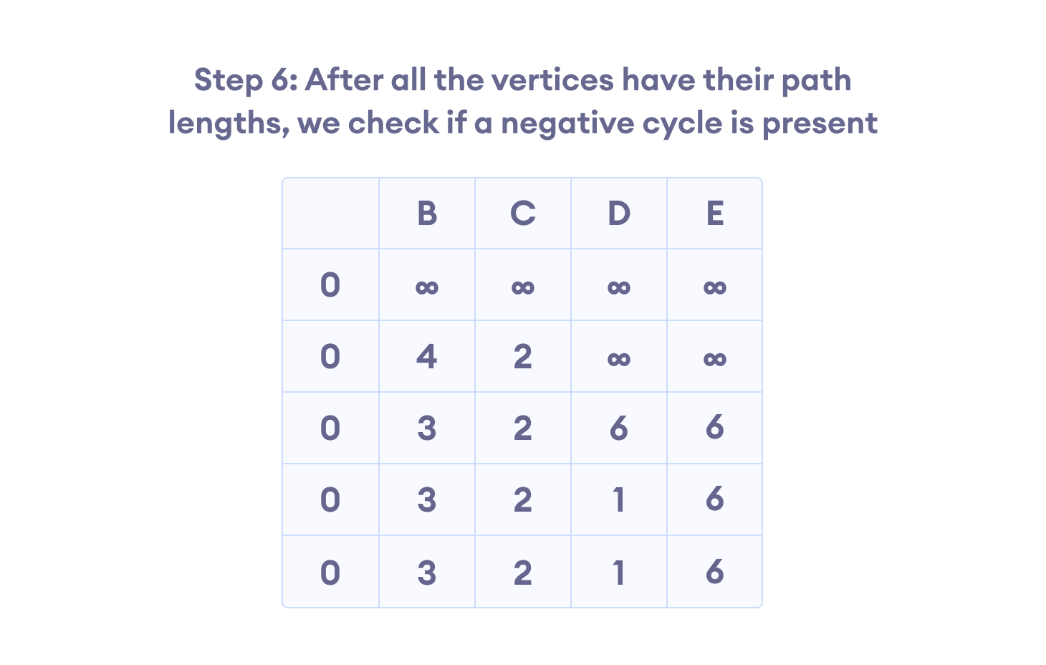
Bellman Ford Algorithm

Slide 122
Daily Quiz
Kruskal’s algorithm is used to ________________
What is the time complexity of Kruskal’s algorithm?
Kruskal’s algorithm is best suited for the dense graphs than the prim’s algorithm.(True/False).
Worst case time complexity of Prim’s algorithm if adjacency matrix is used?
Prim’s algorithm is a ______
Prim’s algorithm resembles Dijkstra’s algorithm.(True/False)
Kruskal’s algorithm is best suited for the sparse graphs than the prim’s algorithm.
Dijkstra’s Algorithm is used to solve _____________ problems.
What is the time complexity of Dijikstra’s algorithm?
Dijkstra’s Algorithm cannot be applied on ______________

Slide 123
Faculty Video Links, You tube & NPTEL Video Links and Online Courses Details
You tube/other Video Links
https://www.youtube.com/watch?v=XB4MIexjvY0
https://www.youtube.com/watch?v=FtN3BYH2Zes
https://www.youtube.com/watch?v=4ZlRH0eK-qQ
https://www.youtube.com/watch?v=co4_ahEDCho

Slide 124
Weekly Assignment
Q1 Solve the 0-1 knapsack problem where you have five objects whose weights are 1, 2, 5, 6, 7 and whose values are 1, 8, 6, 12, 18 and maximum weight is 12. [CO3]
Q2 Solve the 0-1 knapsack problem where you have five objects whose weights are 6, 7, 1, 2, 5 and whose values are 12, 18, 1, 8, 6 and maximum weight is 13. [CO3]
Q3 What is the optimal Huffman Code for the following set of frequencies? a: 05, b: 48, c: 07, d: 17, e: 10, f: 13 [CO3]
Q4 Find the optimal solution for the knapsack 0/1 problem by using the dynamic programming approach? Consider, N = 4, W =5, (w1, w2, w3, w4) = (2, 3, 4, 5) and (b1, b2, b3, b4) = (3, 4, 5, 6) [CO3]

Slide 125
MCQ
Q1 Kruskal’s algorithm is used to ______ (a) find minimum spanning tree (b) find single source shortest path (c) find all pair shortest path algorithm (d) traverse the graph
Q2 Kruskal’s algorithm is a ______ (a) divide and conquer algorithm (b) dynamic programming algorithm (c) greedy algorithm (d) approximation algorithm
Q3 Which of the following is true? a) Prim’s algorithm initializes with a vertex b) Prim’s algorithm initializes with a edge c) Prim’s algorithm initializes with a vertex which has smallest edge d) Prim’s algorithm initializes with a forest

Slide 126
MCQ
Q4 Prim’s algorithm is a ______ (a) Divide and conquer algorithm (b) Greedy algorithm (c) Dynamic Programming (d) Approximation algorithm
Q5 Dijkstra’s Algorithm is used to solve _____________ problems. (a) All pair shortest path (b) Single source shortest path (c) Network flow (d) Sorting
Q6 Dijkstra’s Algorithm cannot be applied on ______________ (a) Directed and weighted graphs (b) Graphs having negative weight function (c) Unweighted graphs (d) Undirected and unweighted graphs

Slide 127
MCQ
Q7 Which of the following methods can be used to solve the Knapsack problem? a) Brute force algorithm b) Recursion c) Dynamic programming d) Brute force, Recursion and Dynamic Programming
Q8 The 0-1 Knapsack problem can be solved using Greedy algorithm. a) True b) False

Slide 128
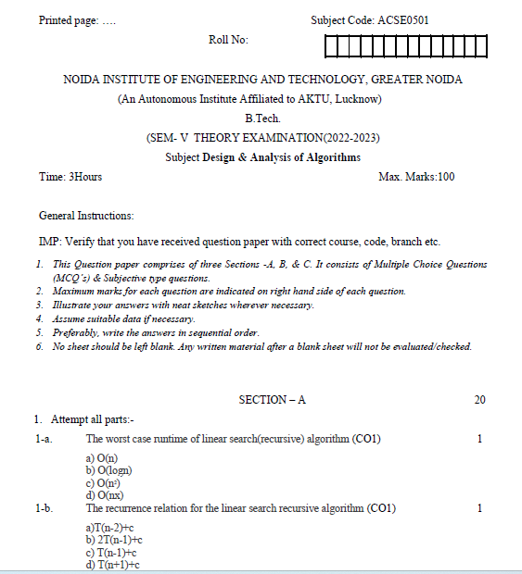
Old Question Papers(2022-2023)

Slide 129
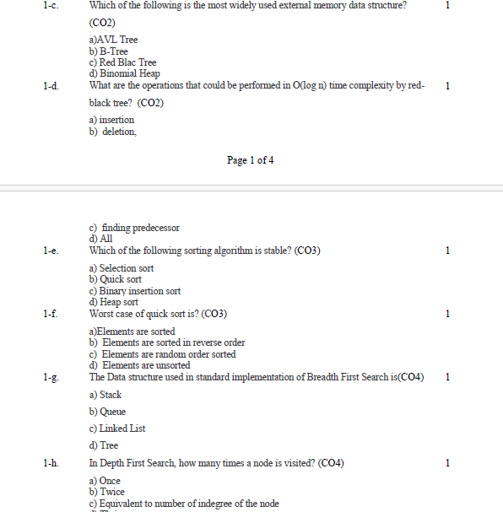
Old Question Papers(2022-2023)

Slide 130
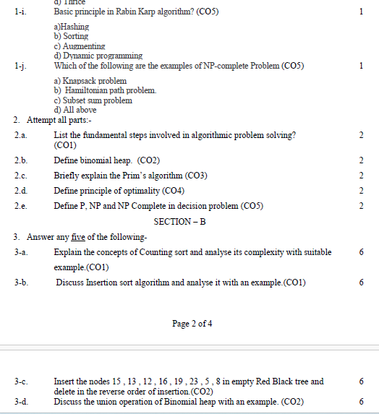
Old Question Papers(2022-2023)

Slide 131
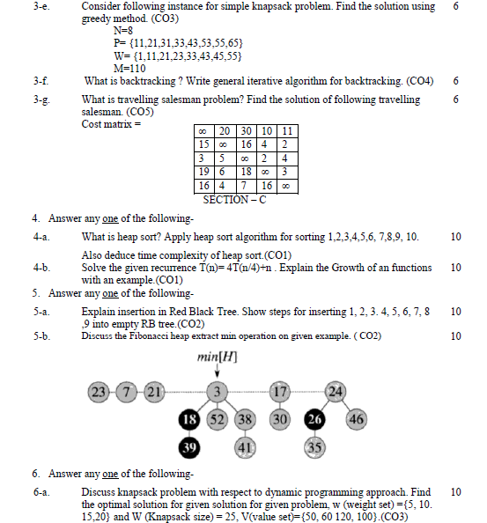
Old Question Papers(2022-2023)

Slide 132
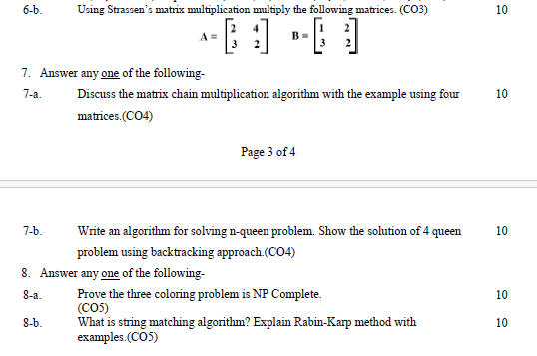
Old Question Papers(2022-2023)

Slide 133
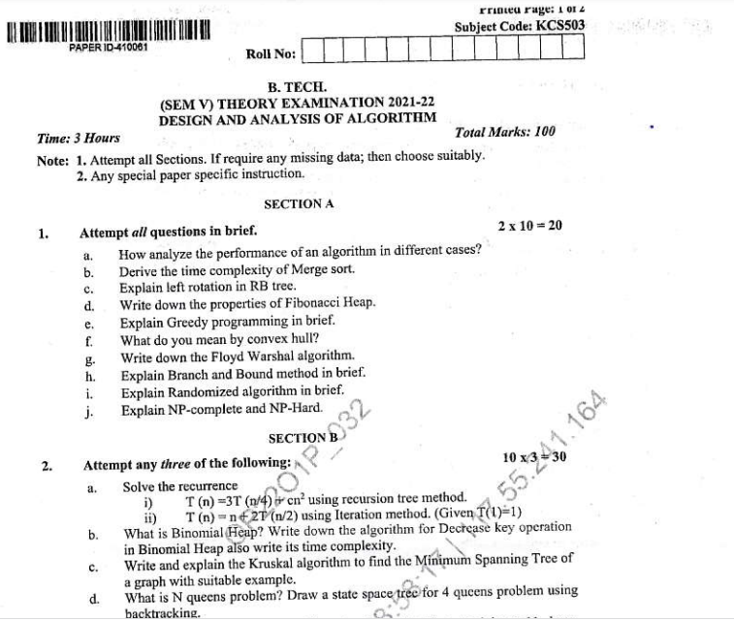
Old Question Papers(2021-2022)

Slide 134
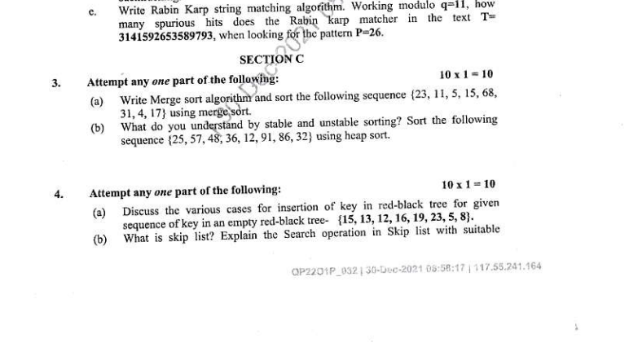
Old Question Papers(2021-2022)

Slide 135
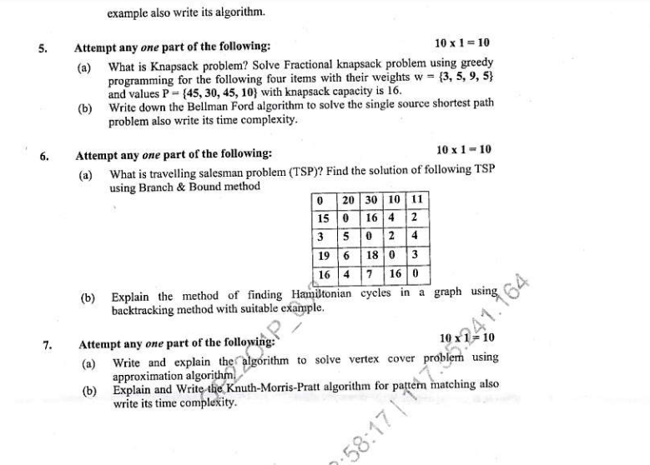
Old Question Papers(2021-2022)

Slide 136
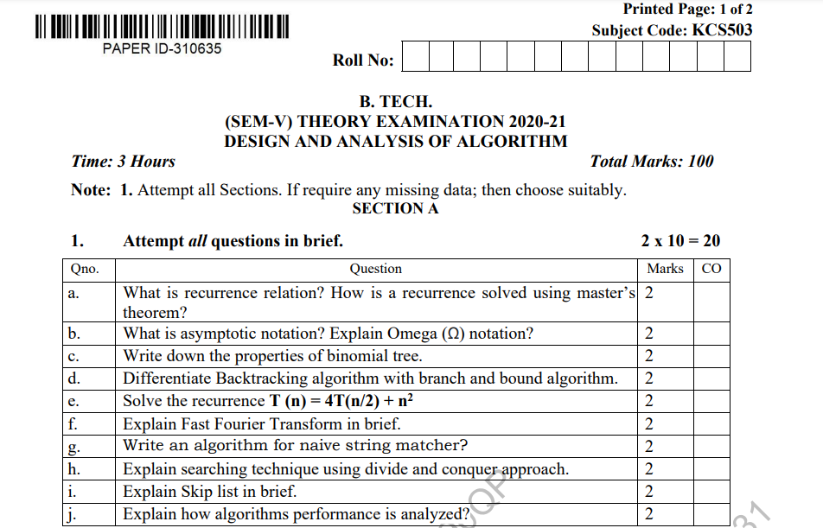
Old Question Papers(2020-2021)

Slide 137
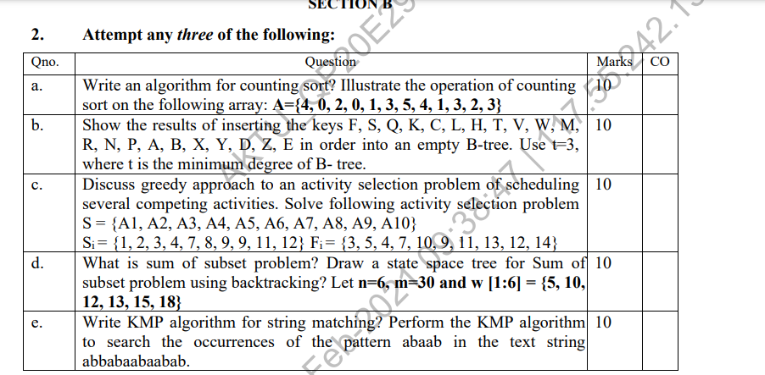
Old Question Papers(2020-2021)

Slide 138
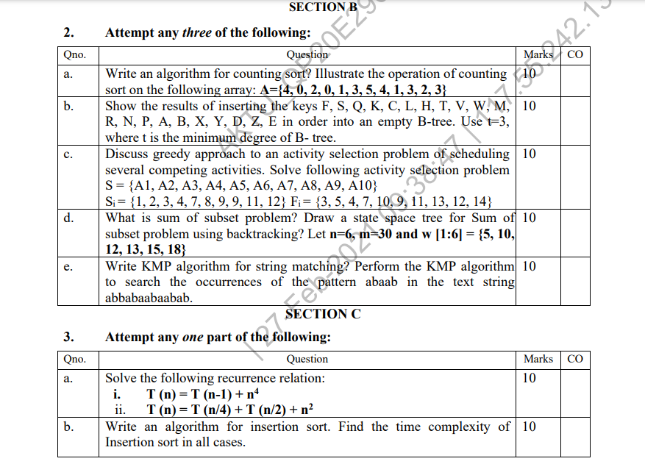
Old Question Papers(2020-2021)

Slide 139

Old Question Papers(2020-2021)

Slide 140

Old Question Papers(2020-2021)

Slide 141

Old Question Papers(2019-2020)

Slide 142

Old Question Papers(2019-2020)

Slide 143


Old Question Papers(2019-2020)

Slide 144

Old Question Papers(2019-2020)

Slide 145


Old Question Papers(2019-2020)

Slide 146


Old Question Papers(2020-2021)

Slide 147

Old Question Papers(2020-2021)

Slide 148


Old Question Papers(2020-2021)

Slide 149


Old Question Papers(2020-2021)

Slide 150

Old Question Papers(2020-2021)

Slide 151


Old Question Papers(2020-2021)

Slide 152


Old Question Papers(2020-2021)

Slide 153


Old Question Papers(2020-2021)

Slide 154

Old Question Papers(2020-2021)

Slide 155

Old Question Papers(2020-2021)

Slide 156
Expected Questions for University Exam
1.Describe activity selection problem. Following are the 9 activities with their start and finish time as
S={1,2,4,1,5,8,9,11,13} F={3,5,7,8,9,10,11,14,16}
Find a schedule where a maximum number of activities can be scheduled. [CO1]
2. Consider following instance for simple Knapsack Problem. Find the solution using greedy method. N:8, Value of knapsack is 110.
V : { 30,20,100,90,160,200,180,220}
W : {5, 10, 20,22,33, 43, 45, 55} [CO1]
3. Discuss the Convex Hull Problem. [CO1]
4. Consider the Following Knapsack Problem . Find the solution
through Greedy Algorithm. N=4, M=60,
Profit={280,150,300,50}, Weight={30,12,20,24}. [CO1]
5. What is minimum spanning tree? Explain any one of minimum
spanning tree algorithm with example. [CO1]

Slide 157
Summary
This objective of this unit was to make the students aware about the different techniques for solving problems. In this unit two concepts have been discussed along with their application to different types of problems.
Divide and conquer has been used in solving the sorting problems. The algorithms being discussed in this regard are Merge sort and Quick sort. Besides this Strassen algorithm for multiplication of matrices have also been discussed.
In Greedy approach different graph algorithms like Dijskstra , Kruskal ,Prims, Huffman Coding and activity selection problem have been explained.

Slide 158
References
Thomas H. Coreman, Charles E. Leiserson and Ronald L. Rivest, “Introduction to
Algorithms”, Printice Hall of India.
E. Horowitz & S Sahni, "Fundamentals of Computer Algorithms",
Aho, Hopcraft, Ullman, “The Design and Analysis of Computer Algorithms” Pearson Education, 2008.
LEE “Design & Analysis of Algorithms(POD)”, McGraw Hill
Richard E.Neopolitan ‘Foundations of Algorithms” Jones & Bartlett Learning.
Gilles Brassard and Paul Bratley, Algorithmics: Theory and Practice, Prentice Hall, 1995.

Slide 159
Unit 3
Thank You

